Slide 1
Multi-Layer Feed-forward Neural Network
The output expressed as a function of the inputs and the weights
Calculate the derivatives of such expressions w.r.t. the weights
The gradient-descent loss-minimization method is used to train the network
Because the function represented by a network can be highly nonlinear—composed, as it is, of nested nonlinear soft threshold functions— neural networks is used as a tool for nonlinear regression

Slide 2
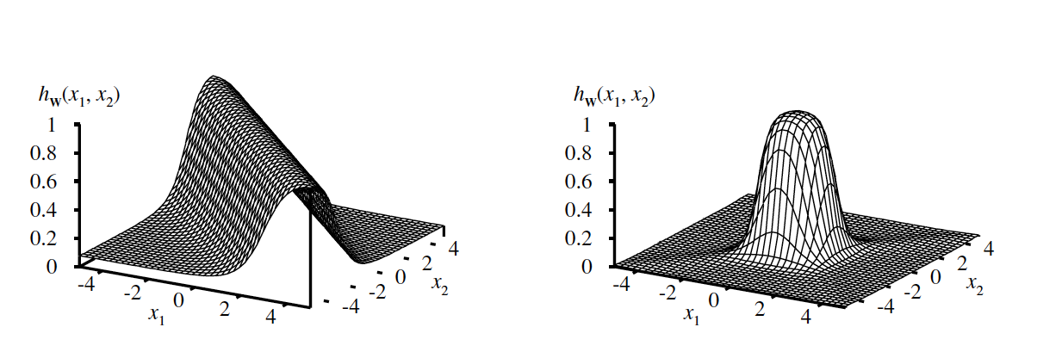
Multi-Layer Feed-forward Neural Network
How do networks generate complicated functions?
Each unit in a sigmoid network represents a soft threshold in its input space
With one hidden layer and one output layer, each output unit computes a soft-thresholded linear combination of several such functions
By adding two opposite-facing soft threshold functions and thresholding the result, a ridge function is obtained
Adding two ridge functions at right angle to each other we can obtain a bump

Slide 3
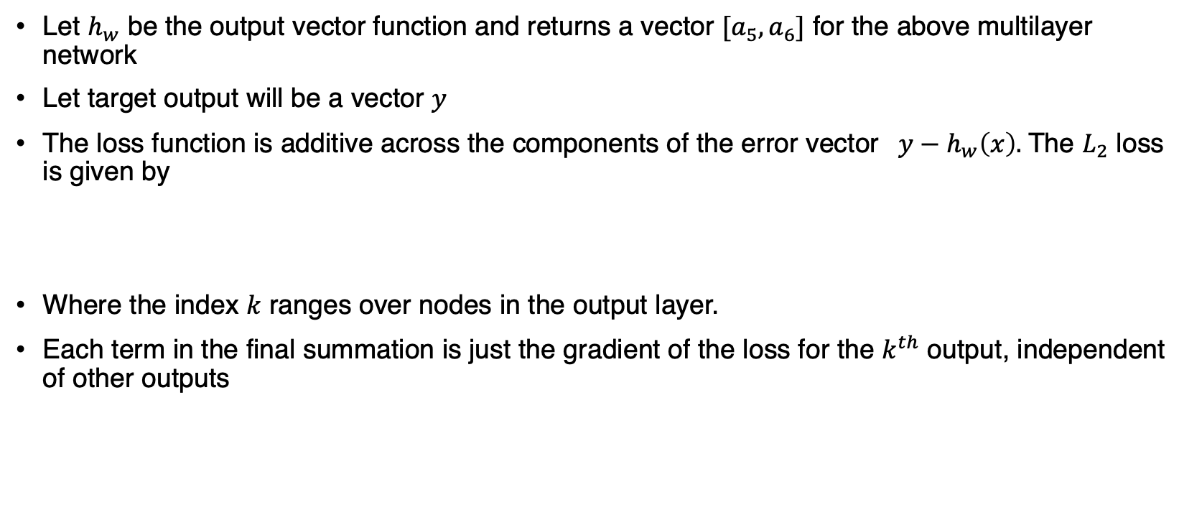
Learning in Neural Networks
Let $h_{w}$ be the output vector function and returns a vector $[a_{5},a_{6}]$ for the above multilayer network
Let target output will be a vector $y$
The loss function is additive across the components of the error vector $y−h_{w}\left(x\right).$The $L_{2}$ loss is given by
Where the index $k$ ranges over nodes in the output layer.
Each term in the final summation is just the gradient of the loss for the $k^{th}$ output, independent of other outputs

Slide 4
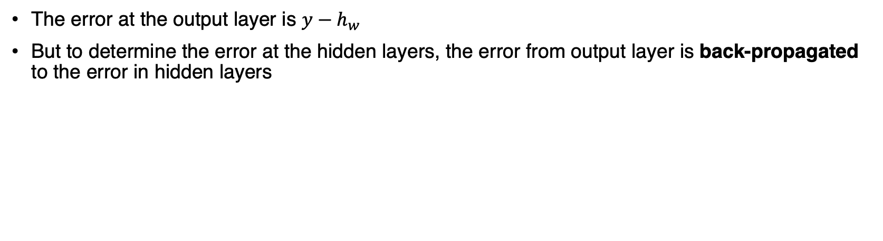
Backpropagation
The error at the output layer is $y−h_{w}$
But to determine the error at the hidden layers, the error from output layer is back-propagated to the error in hidden layers

Slide 5
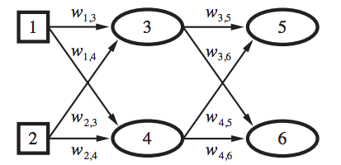
Backpropagation
The back-propagation process is as follows:
Compute the Δ values for the output units, using the observed error.
Starting with output layer, repeat the following for each layer in the network, until the earliest hidden layer is reached:
Propagate the Δ values back to the previous layer.
Update the weights between the two layers.
Where Δ is the error between predicted and target output

Slide 6



Back-Propagation with Example
Initialize all the weights of the network to some random numbers
Now for each example data point,
Propagate the inputs forward to compute the outputs :
Initialize the input activations to the input numbers i.e., $∀ a_{i}=x_{i}$
In our example, $a_{1}=x_{1}$; $a_{2}=x_{2}$
Calculate the hidden and output activations using the formula

Slide 7
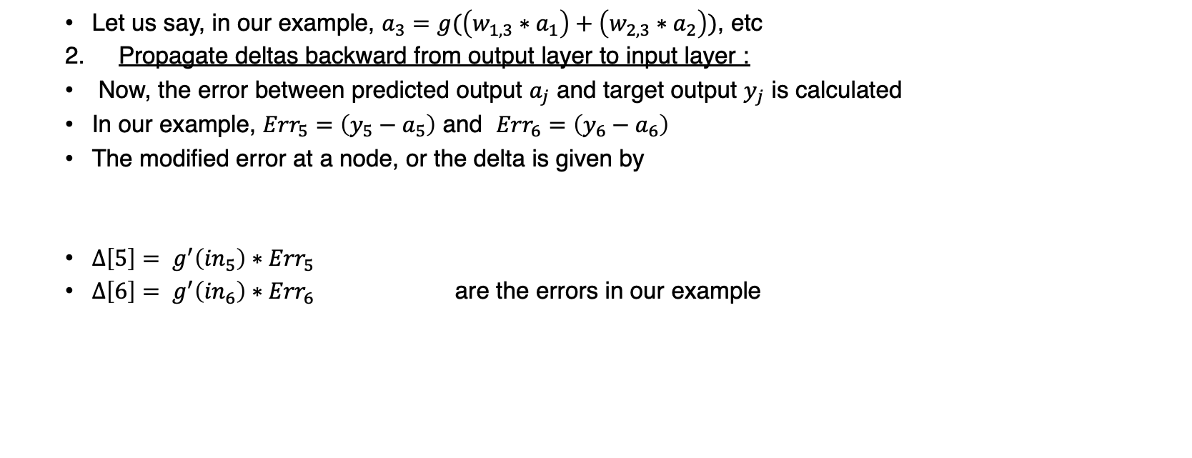
Back-Propagation with Example
Let us say, in our example, $a_{3}=g(\left(w_{1,3}∗a_{1}\right)+\left(w_{2,3}∗a_{2}\right))$, etc
Propagate deltas backward from output layer to input layer :
Now, the error between predicted output $a_{j}$ and target output $y_{j}$ is calculated
In our example, ${Err}_{5}=\left(y_{5}−a_{5}\right)$ and ${Err}_{6}=\left(y_{6}−a_{6}\right)$
The modified error at a node, or the delta is given by
$∆\left[5\right]= g^{′}\left({in}_{5}\right)∗{Err}_{5}$
$∆\left[6\right]= g^{′}\left({in}_{6}\right)∗{Err}_{6}$ are the errors in our example

Slide 8

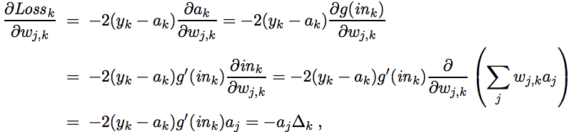
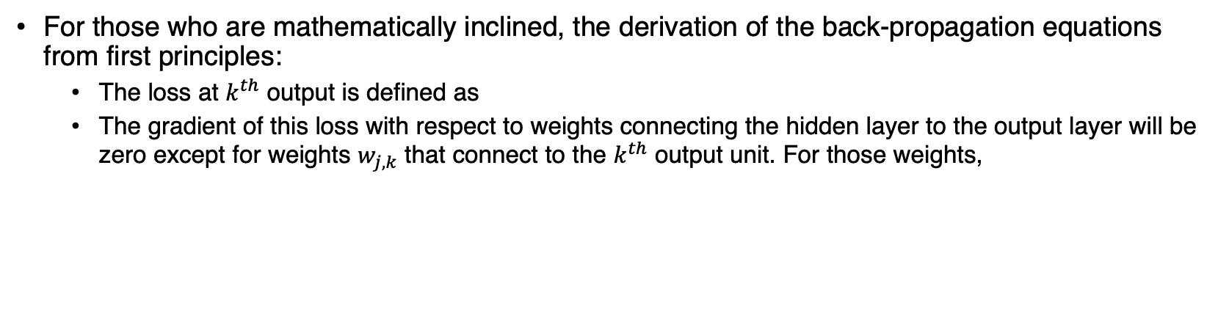
Back-Propagation derivation
For those who are mathematically inclined, the derivation of the back-propagation equations from first principles:
The loss at $k^{th}$ output is defined as
The gradient of this loss with respect to weights connecting the hidden layer to the output layer will be zero except for weights $w_{j,k}$ that connect to the $k^{th}$ output unit. For those weights,

Slide 9
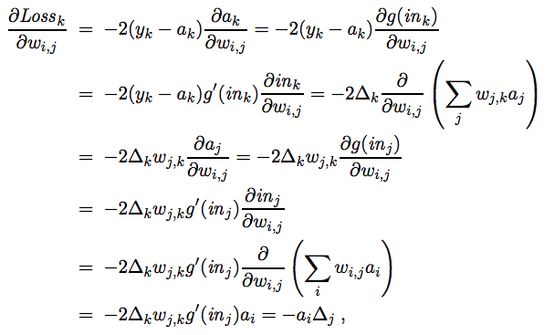
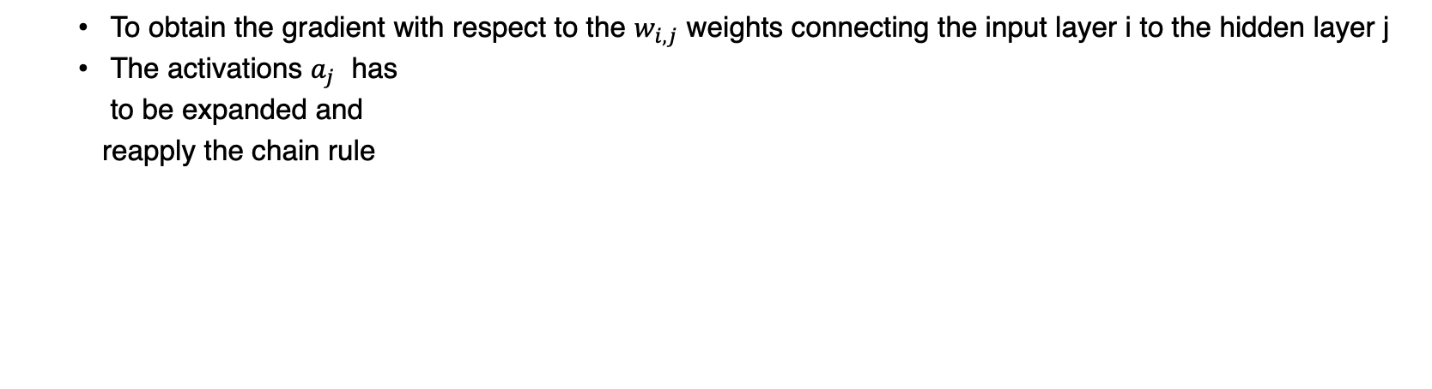
Back-Propagation derivation
To obtain the gradient with respect to the $w_{i,j}$ weights connecting the input layer i to the hidden layer j
The activations $a_{j}$ has
to be expanded and
reapply the chain rule

Slide 10

Back-Propagation with Example
Finally, the last step is to update weights of all layers
The weight update rule is as follows:
𝑤_(𝑗,𝑘) is the weight between the nodes j and k
𝛼 is the learning rate, which specifies how big or small steps should be taken for optimized learning
𝑎_𝑗 output of node j
∆_𝑘is the error at node k

Slide 11
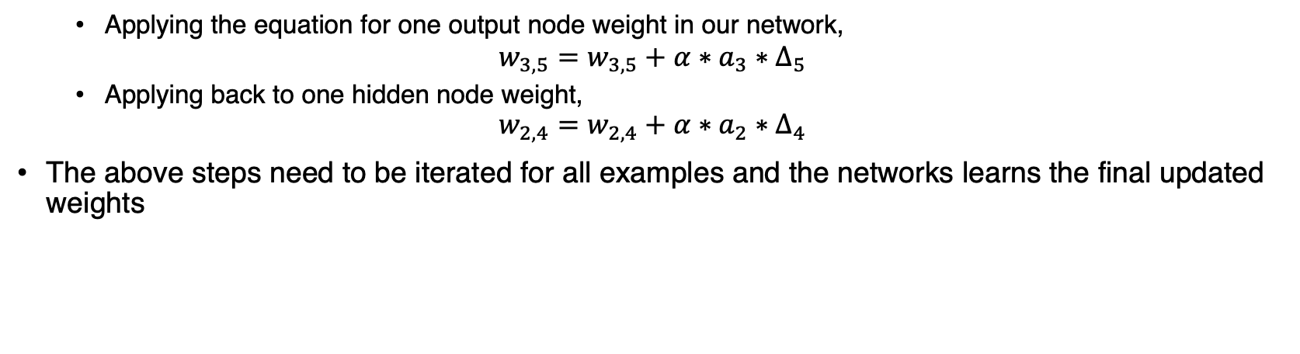
Back-Propagation with Example
Applying the equation for one output node weight in our network,
$$w_{3,5}=w_{3,5}+α∗a_{3}∗∆_{5}$$
Applying back to one hidden node weight,
$$w_{2,4}=w_{2,4}+α∗a_{2}∗∆_{4}$$
The above steps need to be iterated for all examples and the networks learns the final updated weights

Slide 12
Learning neural network structures
In our example, the problem of learning weights, given a fixed network structure; just as with Bayesian networks
How to find the best network structure
If network is too small, couldn’t able to learn properly
If the network is too big, it will memorize all examples and leads to overfitting
For fully connected networks, the only choice to be made concerns the number of hidden layers and their sizes
The usual approach is to try several and keep the best
Cross-validation techniques are used
the network architecture that gives the highest prediction accuracy on the validation sets is chosen

Slide 13
Learning neural network structures
If networks that are not fully connected are considered
The optimal brain damage algorithm begins with a fully connected network and removes connections from it
After the network is trained for the first time, an information-theoretic approach identifies an optimal selection of connections that can be dropped
The network is then retrained, and if its performance has not decreased then the process is repeated
In addition to removing connections, it is also possible to remove units that are not contributing much to the result

Slide 14
Thank You!
In our next session:
Deep Learning

